Slide 1


Concept Selection
Choosing the best part for each function of the machine

Slide 2
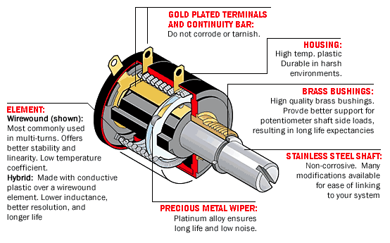
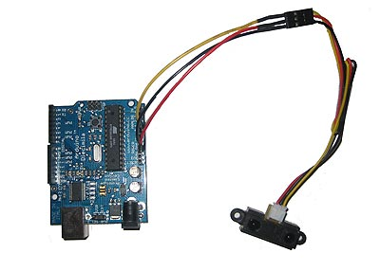
Sensors
Infrared
Optical Encoder
Potentiometer

Slide 3
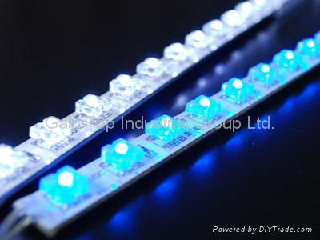
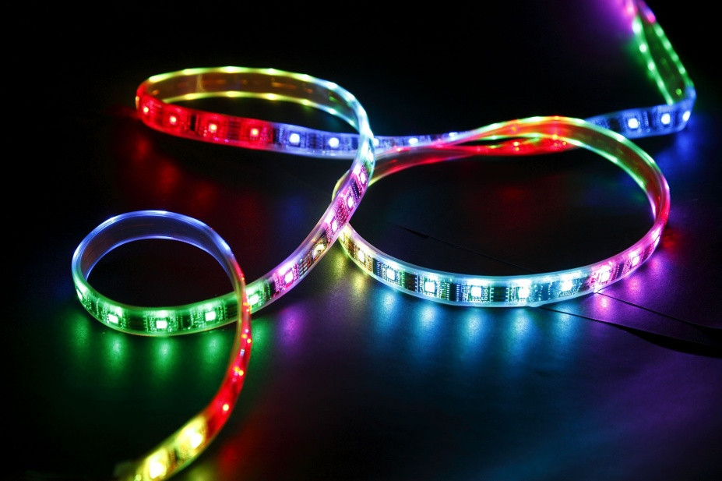
LEDs
RGB LEDs
SMD LEDs
Triple out high power LEDs
Piranha LEDs

Slide 4
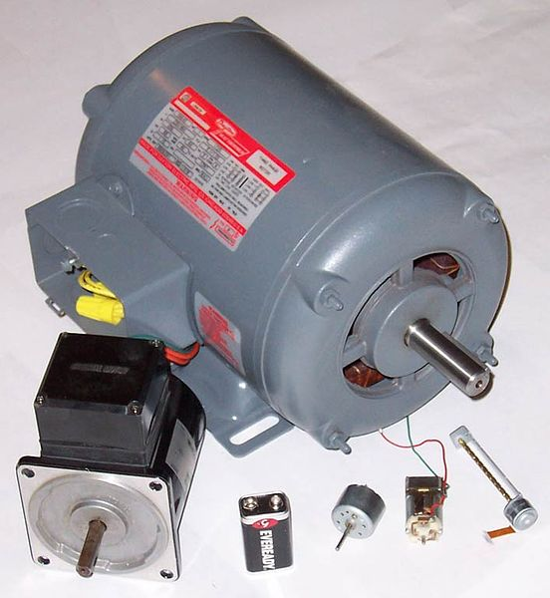
Motor Selection
Brush/brushless DC motors
Synchronous motor
Induction

Slide 5
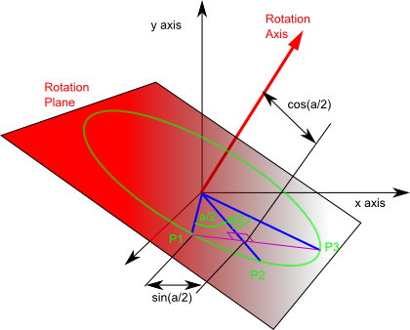
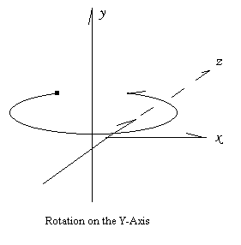
Axis of Rotation

Slide 6
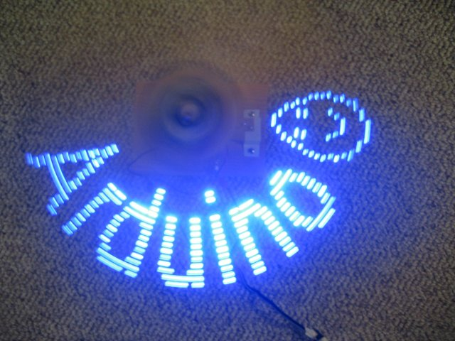
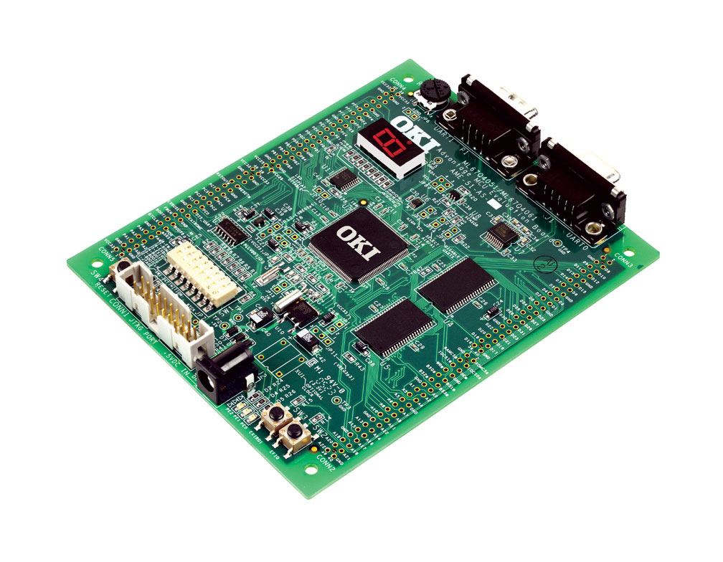
Microcontroller
Arduino
PIC
PSoC

Slide 7
Materials

Slide 8
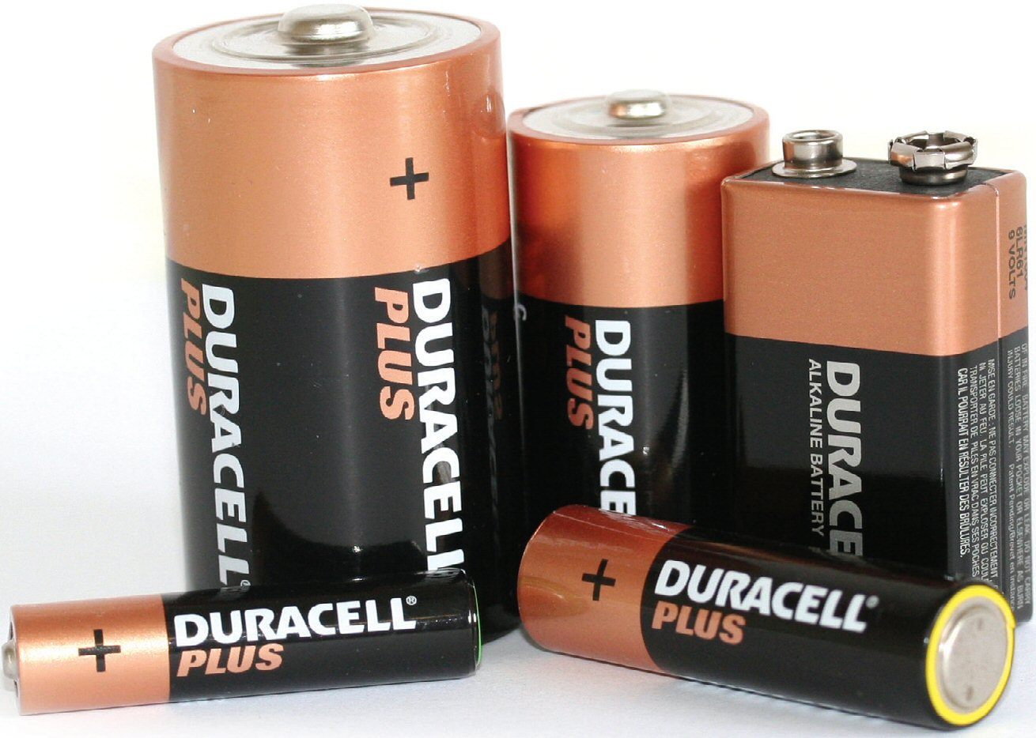
Power Supply
AAA
AA
C
D

